Slide 1

MODULE 3: PROGRAMMING FOR BIOLOGICAL DATA
Hypothesis Testing in the Clinical Laboratory
Session 5: T-tests, Normality, and P-values
Instructor: Dr. Haogao Gu | Date: January 19, 2026

Slide 2







Learning Objectives
Distribution
Normality
T-Tests
Interpretation
Understand the Normal Distribution and its critical role in reference intervals.
Test data for normality using shapiro.test() and Q-Q plots.
Perform one-sample, paired, and two-sample t-tests in R.
Interpret p-values correctly in clinical decision-making contexts.

Slide 3


Why Hypothesis Testing?
The Questions We Ask
The Objective Answer
Hypothesis testing provides a rigorous statistical framework to answer these questions objectively, moving beyond "it looks different" to "it is statistically different."
Is this new reagent lot equivalent to the old one?
Is our analyzer calibrated correctly?
Do viral loads differ between patient groups?

Slide 4

Part 1: The Normal Distribution
Foundations of Clinical Statistics
Duration: 40 minutes

Slide 5
Why "Normal" Matters in the Lab
The Normal (Gaussian) Distribution is the foundation of many laboratory practices.
Application | How Normal Distribution is Used
Reference Intervals | The standard "Mean ± 2SD" calculation covers 95% of a healthy population only if the data is normally distributed.
Quality Control | Levey-Jennings charts rely on the assumption that control values follow a normal distribution.
Statistical Tests | Most parametric tests (like t-tests and ANOVA) assume normality to be valid.

Slide 6

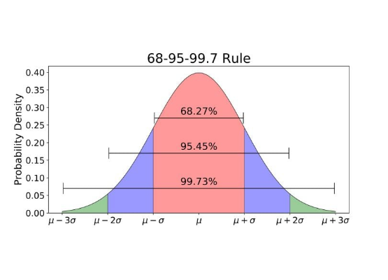
The Bell Curve
Visualizing Hemoglobin
Imagine measuring hemoglobin in 1000 healthy adults:
•
Most values cluster around the center (the mean).
•
Fewer values exist at the extremes (very low or very high).
•
The shape is perfectly symmetric.

Slide 7


Key Properties
Standard Deviation Rules
Clinical Application
•
Mean ± 1SD: Covers ~68% of values
•
Mean ± 2SD: Covers ~95% of values
•
Mean ± 3SD: Covers ~99.7% of values
This captures the central 95% of the healthy population.

Slide 8
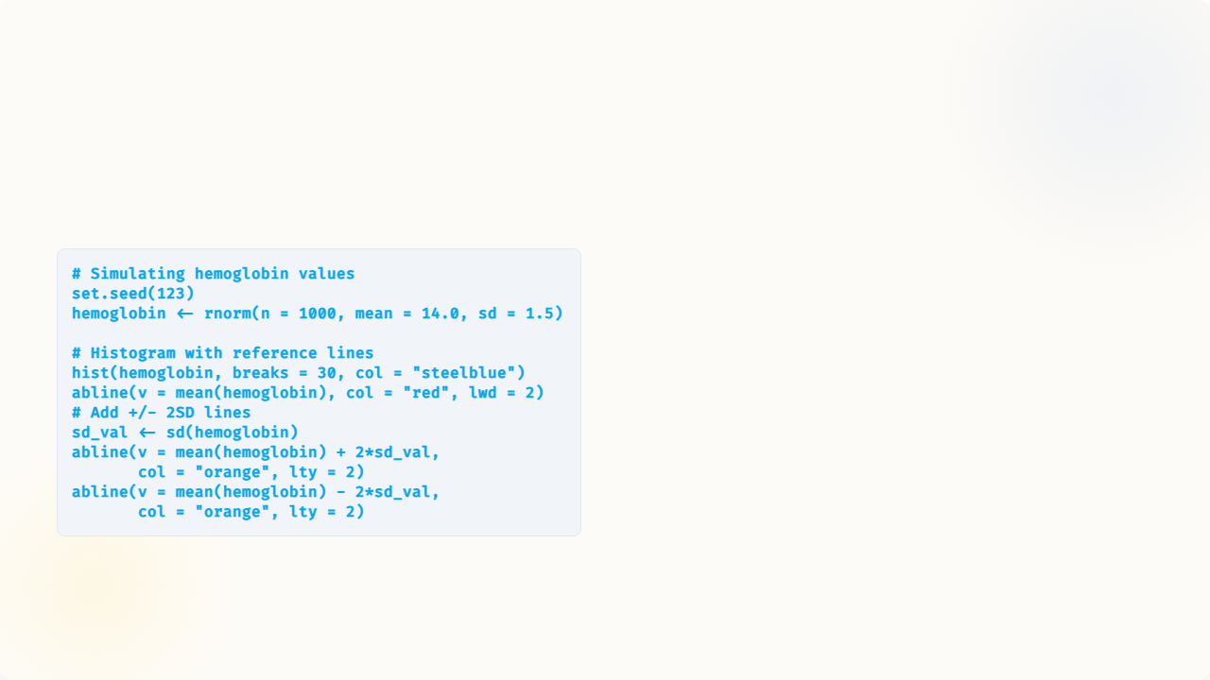
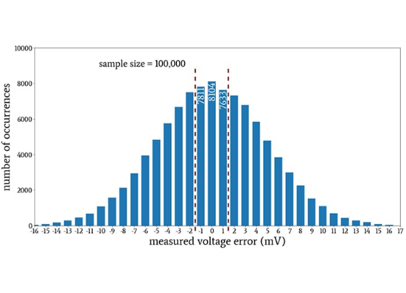
Visualizing the Normal Distribution in R

Slide 9
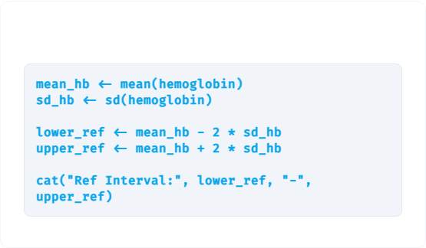


Calculating Reference Intervals
R Code
Expected Output
Based on our simulated data (Mean=14, SD=1.5):
Reference Interval: 11.0 - 17.0 g/dL
This interval would theoretically contain 95% of healthy individuals.

Slide 10
Testing for Normality
Before using parametric tests (like t-tests), you must verify your data is approximately normal.
Method | Type | Tool in R | What to look for
Q-Q Plot | Visual | qqnorm(), qqline() | Points falling along the diagonal line.
Shapiro-Wilk | Statistical | shapiro.test() | P-value > 0.05 (Fail to reject null).

Slide 11
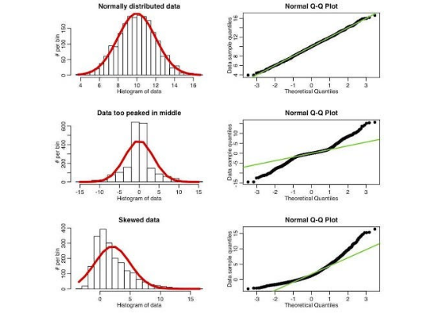
Q-Q Plot: Visual Normality Check
How to Read It
A Q-Q (Quantile-Quantile) plot compares your data against a theoretical normal distribution.
Normal: Points follow the straight diagonal line closely.
Skewed/Non-normal: Points curve away from the line (S-shape or banana shape).

Slide 12

Live Demo: Q-Q Plots in R
Code
Visual Inspection
The code on the left generates two plots side-by-side.
Notice how the Normal Data hugs the red line, while the Skewed Data (exponential distribution) deviates significantly at the ends.

Slide 13
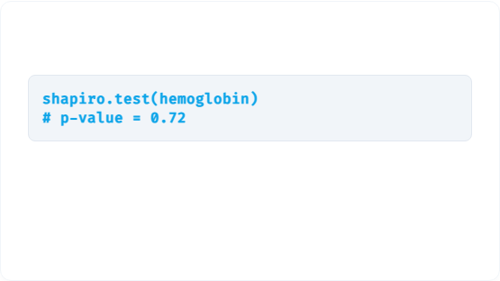


Shapiro-Wilk Test
Interpretation
The Hypothesis
•
H₀ (Null): Data is normally distributed.
•
H₁ (Alternative): Data is NOT normally distributed.
p ≥ 0.05: Fail to reject H₀ → Data may be normal.
p < 0.05: Reject H₀ → Data is NOT normal.

Slide 14



Clinical Relevance: CLSI C28-A3
1
2
3
Test First
Non-Parametric
Transform
Always test reference population data for normality before calculating intervals.
If data is not normal (and cannot be transformed), use non-parametric methods (percentiles) instead of Mean ± 2SD.
Consider data transformation (e.g., Log10) to normalize skewed distributions like viral loads.

Slide 15

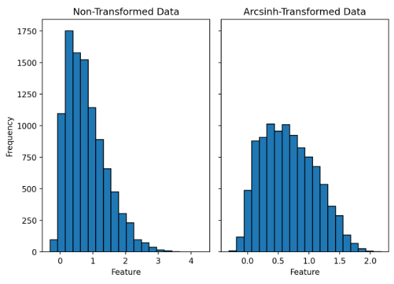
Log Transformation for Skewed Data
Viral loads are typically right-skewed. Log-transformation often normalizes them, allowing the use of parametric tests.

Slide 16

Part 2: T-Tests — Comparing Means
Statistical Comparisons in the Lab
Duration: 40 minutes

Slide 17
The Logic: A Courtroom Analogy
Courtroom Concept | Hypothesis Testing Equivalent
Innocent until proven guilty | H₀: No difference (Null Hypothesis is assumed true initially)
Evidence must be convincing | P-value measures the strength of evidence against H₀
"Beyond reasonable doubt" | p < 0.05 → Reject H₀ (Statistically Significant)
"Not enough evidence" ≠ Innocent | p ≥ 0.05 → Fail to reject H₀ (Not proven equal, just no difference found)

Slide 18


Understanding the P-value
"The probability of obtaining results at least as extreme as the observed results, assuming that the null hypothesis is correct."
p < 0.05
p ≥ 0.05
Statistically Significant
Not Significant
Strong evidence against H₀.
Insufficient evidence to reject H₀.

Slide 19
Which T-Test to Use?
Scenario | Test Type | R Function
Compare a sample mean to a known standard/target. | One-sample t-test | t.test(x, mu = value)
Compare same subjects under two conditions (e.g., Method A vs B). | Paired t-test | t.test(x, y, paired = TRUE)
Compare two independent groups (e.g., Delta vs Omicron patients). | Two-sample t-test | t.test(x, y)

Slide 20


Scenario 1: One-Sample T-Test
Clinical Scenario
The Question
You receive a new lot of QC material.
Does your analyzer measure at the target?
•
Manufacturer states target glucose = 100 mg/dL.
H₀: Mean = 100 mg/dL
•
You run 20 replicates on your analyzer.
H₁: Mean ≠ 100 mg/dL

Slide 21
One-Sample T-Test in R
qc_glucose <- c(101, 103, 99, 102, 100, 104, 98, 103, 101, 102, 100, 105, 99, 101, 103, 102, 100, 104, 101, 103) target <- 100 # Perform t-test t.test(qc_glucose, mu = target) # Output: # t = 3.25, df = 19, p-value = 0.004 # mean of x: 101.55 # 95% CI: [100.5, 102.3]

Slide 22



Interpreting the Output
P-value
Mean Estimate
Decision
0.004
101.55
Bias Detected
Since p < 0.05, we reject H₀. There is a statistically significant difference.
Our measured mean is ~1.55 mg/dL higher than the target of 100.
The analyzer has a significant positive bias.

Slide 23

Scenario 2: Paired T-Test (Method Comparison)
The Setup
Validating a new reagent (Method B) against the current one (Method A).
Why "Paired"?
We analyze the differences (A - B) for each patient.
•
Measure 20 patients with BOTH methods.
If Mean Difference ≈ 0 → Methods are equivalent.
•
Samples are paired because measurements come from the same patient.
If Mean Difference ≠ 0 → Systematic bias exists.

Slide 24
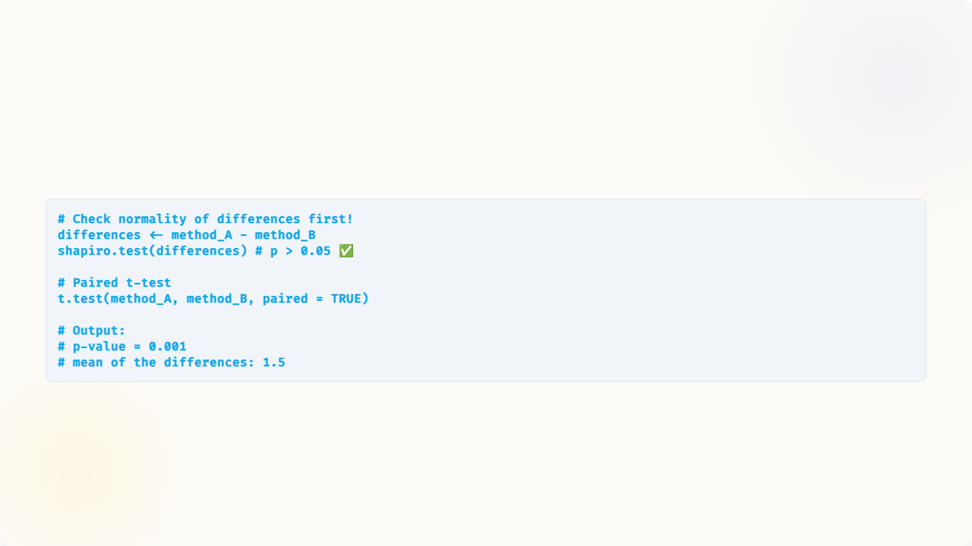
Paired T-Test in R
Result: A statistically significant bias of 1.5 mg/dL exists between the methods.

Slide 25
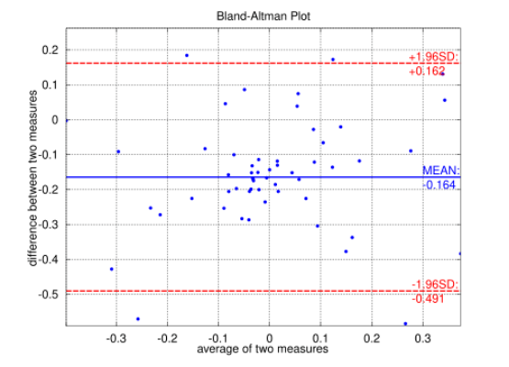
Visualizing Difference: Bland-Altman Plot
The Bland-Altman (Difference) plot is the standard for method comparison.
•
X-axis: Mean of the two methods ((A+B)/2).
•
Y-axis: Difference between methods (A-B).
•
Horizontal Lines: Mean Bias (solid) and 95% Limits of Agreement (dashed).

Slide 26

Statistical vs. Clinical Significance
Critical Concept!
Even if p < 0.05 (statistically significant), you must ask:
"Is the difference clinically meaningful?"
A 1.5 mg/dL bias in glucose might be statistically significant but is likely clinically irrelevant given biological variation.

Slide 27
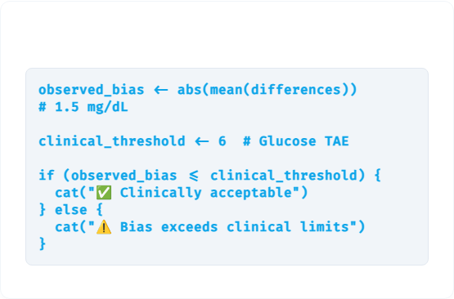

Making a Clinical Decision
R Implementation
The Logic
Compare the observed bias against Total Allowable Error (TAE) specifications.
For Glucose, TAE is typically ±6 mg/dL or 10%.

Slide 28
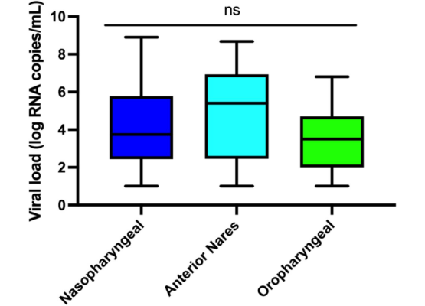
Scenario 3: Two-Sample (Independent) T-Test
Clinical Scenario
Do COVID-19 patients infected with Delta variant have different viral loads than Omicron?
•
Two independent groups of patients.
•
Different sample sizes possible.

Slide 29


Interpreting Variant Comparison
Interpretation
Results
Recall that PCR Ct values are logarithmic.
•
Delta Mean Ct: 18.6
A difference of ~3.3 Ct represents a 10-fold difference in viral copies.
•
Omicron Mean Ct: 21.8
•
Difference: 3.2 cycles
Conclusion: Delta patients had significantly higher viral loads (~10x).

Slide 30



Before ANY T-Test: Check Assumptions
1
2
3
Normality
Independence
Variance
Use Shapiro-Wilk or Q-Q plots. If failed, use Wilcoxon (non-parametric).
Samples must be independent (or properly paired for paired tests).
For two-sample tests, check equal variance. If unequal, use Welch's t-test (default in R).

Slide 31
Summary: Which T-Test?
Scenario | Test | Key Assumption
Sample vs. Known Value | One-sample | Sample is normal
Same subjects, 2 conditions | Paired | Differences are normal
Two independent groups | Two-sample | Both groups normal
Always: Check normality first!

Slide 32

Tutorial 5
Method Validation Study: Practical Application
Open your R environment

Slide 33


Tutorial Scenario
Task
Role
•
Data: 20 patient samples measured by Method A (Current) and Method B (New).
You are a Medical Laboratory Technologist validating a new glucose reagent lot.
•
Goal: Determine if there is systematic bias.
•
Question: "Is the new lot statistically and clinically equivalent?"

Slide 34




What You'll Practice
Steps 1-2
Step 3
Step 4
Step 5-6
Load Data & Calculate Differences
Test Normality (Histogram/Shapiro)
Perform Paired T-Test
Clinical Significance & Bland-Altman Plot

Slide 35
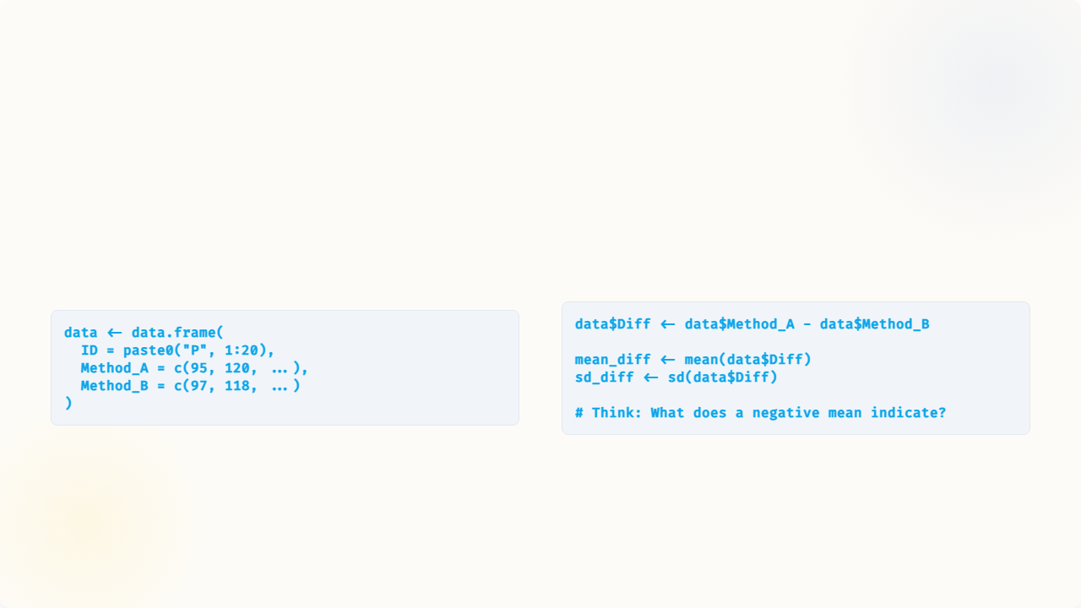
Step 1 & 2: Load and Difference
Load Data
Calculate Differences

Slide 36

Step 3: Test Normality
Before the t-test, verify the differences are normal.
Rule: If p ≥ 0.05, the data is normal, and we can proceed with the paired t-test.

Slide 37


Step 4: Perform Paired T-Test
Find these values in output:
•
t statistic: Magnitude of difference relative to variance.
•
p-value: Significance of the difference.
•
95% CI: The range of the true bias.
•
mean of differences: The observed bias.

Slide 38
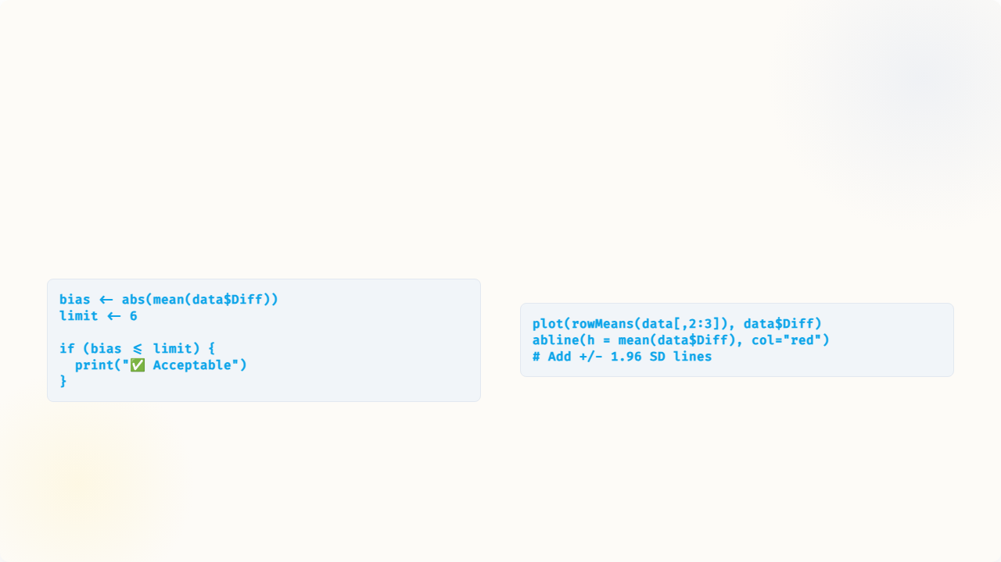
Step 5 & 6: Significance & Plot
Check Clinical Limits
Bland-Altman Plot

Slide 39

Challenge: Validation Report
Write a 3-5 sentence summary including:
1.
Number of samples compared (n=20).
2.
Mean bias and direction (Method A vs B).
3.
Statistical significance (p-value).
4.
Clinical acceptability (vs. ±6 mg/dL).
5.
Final Recommendation: Approve or Reject?

